Slide 1

University of North Texas
CSCE 2110
Foundations of Data Structures
Abstract Data Type, List, Stack, and Queue
Notes:
今天我们要学习数据结构里面非常重要的一部分内容：抽象数据类型（ADT）、线性表、栈和队列。

Slide 2
Contents
Abstract data type
Array
List, Stack, and Queue
ADT
Implementations
Algorithm analysis
Applications
Postfix conversion
Notes:
主要内容包括抽象数据类型、数组、线性表、栈和队列。我们还会学习它们的实现方法、算法分析、一些实际应用，以及一个非常重要的主题：中缀表达式到后缀表达式的转换。

Slide 3
Elementary Data Structures
“Mankind’s progress is measured by the number of things we can do without thinking.”
Elementary data structures such as stacks, queues, lists, and heaps are the “off-the-shelf” components we build our algorithm from.
A data organization, management, and storage format that enables efficient access and modification.
There are two aspects to any data structure:
The abstract operations which it supports (abstract data type, ADT).
The implementation of these operations.
Notes:
“在计算机科学里，栈（stack）、队列（queue）、线性表（list）、堆（heap） 等等，这些都是我们常说的基础数据结构。它们就像是算法的‘乐高积木’，是现成的组件，可以随时拿来搭建更复杂的算法。
数据结构的本质是：组织、管理和存储数据，并且要让数据的访问和修改尽可能高效。”
“任何数据结构，其实都可以从两个角度来理解：抽象操作（ADT）,也就是它对外承诺能做什么。举例：银行data structure；这些抽象操作不关心实现细节。
操作的实现（Implementation）：也就是到底用什么方法实现这些操作。比如，银行可以用不同的数据库来实现

Slide 4
Data Abstraction
That we can describe the behavior of our data structures in terms of abstract operations is why we can use them without thinking.
Push(x, s) – Insert item 𝑥 at the top of stack 𝑠.
Pop(s) – Return (and remove) the top item of stack 𝑠.
That there are different implementations of the same abstract operations enables us to optimize performance in difference circumstances.
Notes:
所谓数据抽象，就是用一组抽象操作来描述数据结构的行为，而不用关心它内部是怎么实现的。比如说栈。我们只需要记住两个操作：Push(x, s)：把元素 x 放到栈 s 的顶部; Pop(s)：取出并删除栈顶元素。
这里我们完全没有提到底层是用数组还是用链表来存储的。为什么？因为抽象操作只关注能做什么，而不管怎么做。正因为有了这种抽象，我们在写程序时可以直接调用这些操作，而不用重新造轮子。
同时，同一个抽象操作可能有不同的实现方式，
比如：用数组实现的栈：访问速度快，但扩容麻烦。用链表实现的栈：插入删除方便，但需要额外存储指针。

Slide 5
Fundamental Data Structures
Data structures can be neatly classiﬁed as either contiguous or linked, depending upon whether they are based on arrays or pointers:
Contiguously-allocated structures are composed of single slabs of memory, and include arrays, matrices, heaps, and hash tables.
Linked data structures are composed of multiple distinct chunks of memory bound together by pointers, and include lists, trees, and graph adjacency lists.
Notes:
顺序存储（Contiguously-allocated）“顺序存储的特点是：数据放在内存中的一块连续区域。比如数组。数组就是典型的顺序存储，所有元素紧挨着存放。矩阵、堆、哈希表，本质上也是依赖连续内存的。
下标访问速度非常快，O(1)。
插入和删除往往需要移动大量元素。大小固定或扩展不灵活。”
链式存储的特点是：数据分散在内存各处，用指针连接起来。比如链表（list）、树（tree）、图的邻接表（graph adjacency list）
优点：插入删除很方便，不需要移动大量元素。
访问效率低，必须通过指针一个个找过去。指针需要额外的存储空间。

Slide 6
Array — Abstract Data Type
The array is an abstract data type (ADT) that holds a collection of elements accessible by an index.
elements can be anything, primitive types such as integers to more complex types like instances of classes
Notes:
接下来我们重点讲第一个基础数据结构：数组（Array）。数组是所有数据结构里最常见、最基础的形式，很多其他结构，比如栈、队列，都是在数组的基础上实现的。
数组的本质是：一块连续的内存空间，存放同一种数据类型的元素。每个元素都有唯一的下标（index）。访问时可以通过下标直接定位，效率是 O(1)。”

Slide 7
Array — Abstract Data Type
The array is an abstract data type (ADT) that holds a collection of elements accessible by an index.
elements can be anything, primitive types such as integers to more complex types like instances of classes
Minimal Required Functionality
set(i, v) -> Sets the value of index i to v
get(i) -> Returns the value of index i in the array
Notes:
最小功能需求: 如果要定义数组这个 ADT，它至少要支持以下两个基本操作：
set(i, v)：把下标 i 的位置设置为值 v
get(i)：返回下标 i 的位置上的值。

Slide 8
Array — Data Structure
An array is a structure of ﬁxed-size data records such that each element can be efﬁciently located by its index or (equivalently) address.
Advantages of contiguously-allocated arrays include
Constant-time access given the index.
Arrays consist purely of data, so no space is wasted with links or other formatting information.
Physical continuity (memory locality) between successive data accesses helps exploit the high-speed cache memory on modern computer architectures.
Notes:
数组是固定大小的数据记录集合，可以通过下标或地址快速定位元素
顺序存储数组的优势：
下标访问是 O(1) 常数时间。
只存数据，不需要额外指针开销。
连续内存带来的局部性优势，可以更好利用高速缓存（cache）。

Slide 9
Dynamic Arrays
Unfortunately, we cannot adjust the size of simple arrays in the middle of a program’s execution.
Compensating by allocating extremely large arrays can waste a lot of space.
With dynamic arrays we start with an array of size 1 and double its size from 𝑚 to 2𝑚 each time we run out of space.
Notes:
普通数组的大小在程序运行时不能改变。
如果一开始分配很大空间，可能会浪费内存。
动态数组的解决方案是：从一个小数组开始，每次不够用时就把容量翻倍

Slide 10
Dynamic Arrays
Unfortunately, we cannot adjust the size of simple arrays in the middle of a program’s execution.
Compensating by allocating extremely large arrays can waste a lot of space.
With dynamic arrays we start with an array of size 1 and double its size from 𝑚 to 2𝑚 each time we run out of space.
How many times will we double for 𝑛 elements?
Notes:
那有一个很自然的问题： 如果我们要存放 n 个元素，到底需要扩容几次？

Slide 11
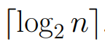
Dynamic Arrays
Unfortunately, we cannot adjust the size of simple arrays in the middle of a program’s execution.
Compensating by allocating extremely large arrays can waste a lot of space.
With dynamic arrays we start with an array of size 1 and double its size from 𝑚 to 2𝑚 each time we run out of space.
How many times will we double for 𝑛 elements?

Slide 12
How Much Total Work?
The apparent waste in this procedure involves the recopying of the old contents on each expansion.
Item No.: 1 | 2 | 3 | 4 | 5 | 6 | 7 | 8 | 9 | 10 …

Slide 13
How Much Total Work?
The apparent waste in this procedure involves the recopying of the old contents on each expansion.
Item No.: 1 | 2 | 3 | 4 | 5 | 6 | 7 | 8 | 9 | 10 …
Array size: 1 | 2 | 4 | 4 | 8 | 8 | 8 | 8 | 16 | 16 …
Cost: 1 | 2 | 3 | 1 | 5 | 1 | 1 | 1 | 9 | 1 …
1 + 1 + ⋯ 1 + (1 + 2 + 4 + ⋯)
𝑛 items lg(𝑛 − 1)+1 items
Cost ≤ 𝑛 + 2𝑛 = 3𝑛 = 𝑂(𝑛)

Slide 14
List ADT
A list contains elements of same type arranged in sequential order operations performed on the list:
get() – Return an element from the list at any given position.
insert() – Insert an element at any position of the list.
remove() – Remove the first occurrence of any element from a non-empty list.
removeAt() – Remove the element at a specified location from a non-empty list.
replace() – Replace an element at any position by another element.
size() – Return the number of elements in the list.
isEmpty() – Return true if the list is empty, otherwise return false.
isFull() – Return true if the list is full, otherwise return false.
Notes:
接下来我们讲 List（线性表）。 线性表是数据结构中最基本的一类，它包含相同类型的元素，并且这些元素是按顺序排列的。

Slide 15
Pointers and Linked Structures
Pointers represent the address of a location in memory. A cell-phone number can be thought of as a pointer to its owner as they move about the planet.
In C/C++, *p denotes the item pointed to by p, and &x denotes the address (i.e., pointer) of a particular variable x.
A special NULL pointer value is used to denote structure terminating or unassigned pointers.

Slide 16
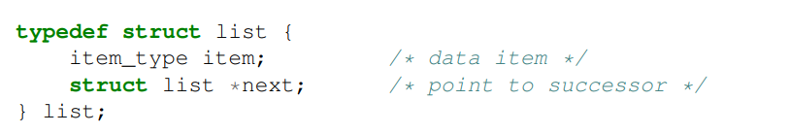
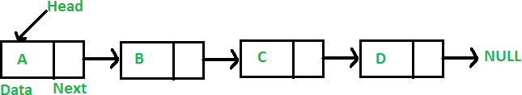
Linked List

Slide 17
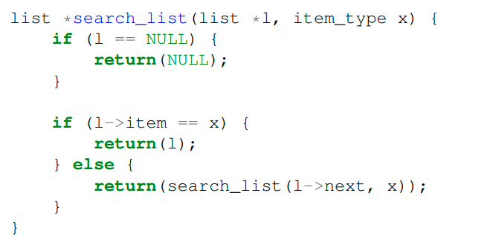
Searching a List
Searching in a linked list can be done iteratively or recursively.

Slide 18
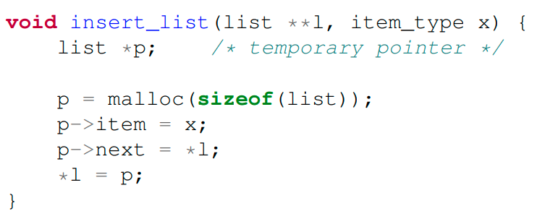
Insertion into a List
Since we have no need to maintain the list in any particular order, we might as well insert each new item at the head.

Slide 19
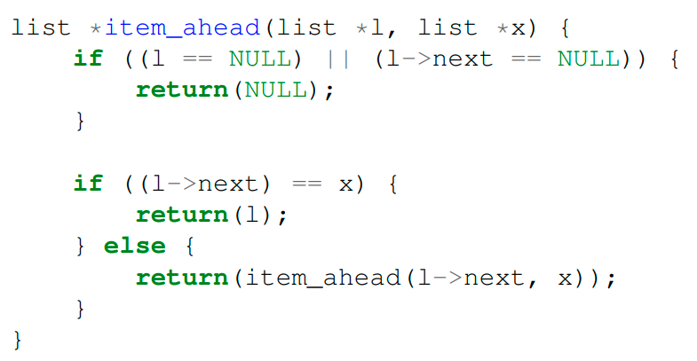
Deleting from a List: Find Predecessor

Slide 20
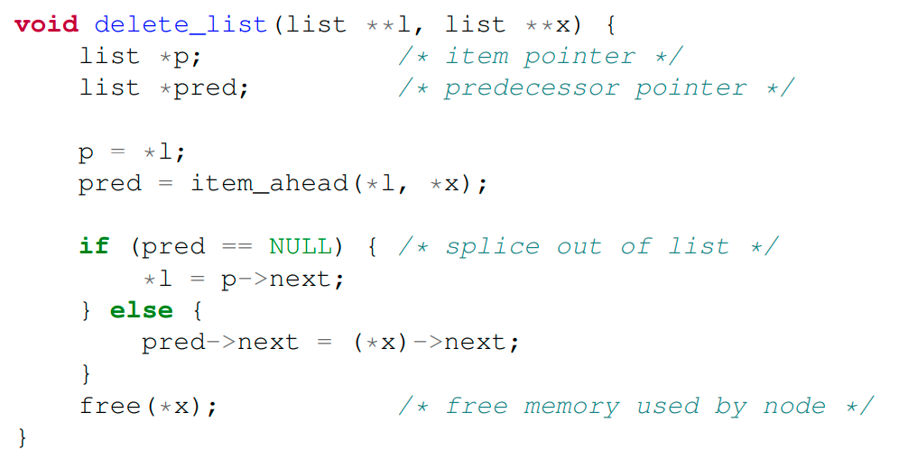
Deleting from a List: Remove Item

Slide 21
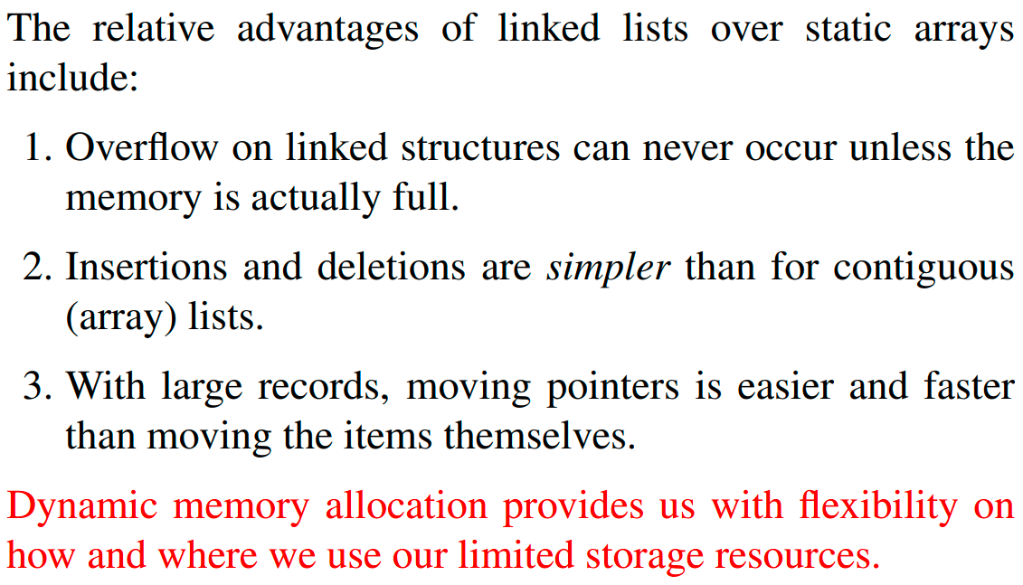
Advantages of Linked Lists

Slide 22
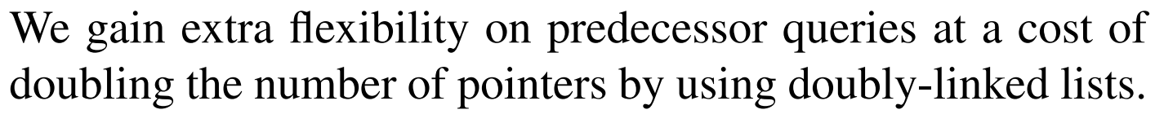
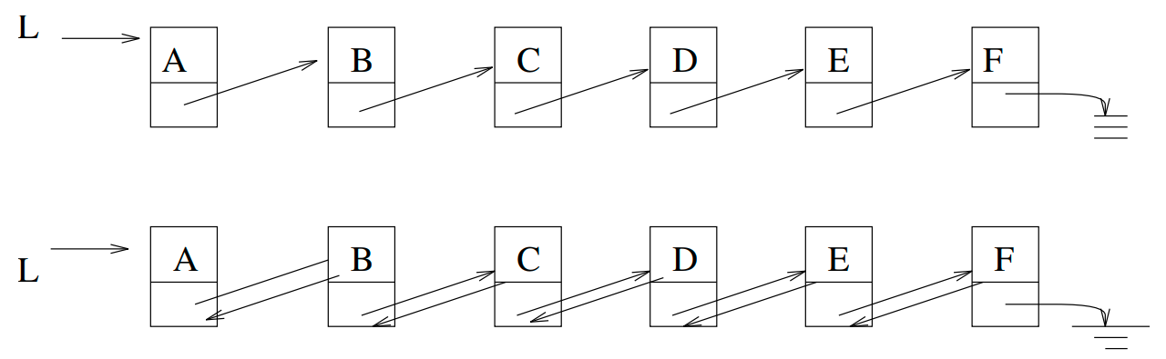
Singly or Doubly Linked Lists
Singly
Doubly

Slide 23
What Is a Stack?
Stores a set of elements in a particular order
Stack principle: LAST IN FIRST OUT
= LIFO
It means: the last element inserted is the first one to be removed
Notes:
同学们，我们现在进入一个非常重要的数据结构 —— 栈（Stack）。 栈是一种存储数据的方式，但它有一个特别的原则：后进先出（Last In First Out, LIFO）
原则是：最后放进去的，最先被取出来。

Slide 24

What Is a Stack?
Stores a set of elements in a particular order
Stack principle: LAST IN FIRST OUT
= LIFO
It means: the last element inserted is the first one to be removed
Example
Which is the first element to pick up?
Notes:
大家看到，这里有几摞盘子。假设每次只能把盘子放到最上面，取的时候也只能从最上面拿。
那么我问大家：如果要取盘子，第一个能拿到的盘子是哪一个？

Slide 25
What Is a Stack?
Stores a set of elements in a particular order
Stack principle: LAST IN FIRST OUT
= LIFO
It means: the last element inserted is the first one to be removed
Example
Applications
“Undo” operation
Call function in program
…
Which is the first element to pick up?
Notes:
Undo 撤销操作
大家在 Word 里点 ‘撤销’ 按钮时，最近的一步操作最先被撤销。这就是一个典型的栈：每次操作都压入栈，撤销时再从栈顶弹出。
函数调用（Call function in program）
程序在运行时，每次函数调用都会压入一个栈帧。当函数执行完，就从栈顶弹出，返回到上一个函数。所以我们把它叫做 调用栈（call stack）。

Slide 26
Stack ADT
A finite ordered list with zero or more elements
Methods
push() – Insert an element at one end of the stack called top.
pop() – Remove and return the element at the top of the stack, if it is not empty.
peek() – Return the element at the top of the stack without removing it, if the stack is not empty.
size() – Return the number of elements in the stack.
isEmpty() – Return true if the stack is empty, otherwise return false.
isFull() – Return true if the stack is full, otherwise return false.
Notes:
我们现在正式把栈当作一个抽象数据类型（ADT）来看。栈就是一个有限的有序集合，里面可以有零个或多个元素。它的操作非常明确，下面我们逐个来看。

Slide 27
Implementing a Stack
At least two different ways to implement a stack
array
linked list
Which method to use depends on the application
what advantages and disadvantages does each implementation have?
Notes:
我们已经知道栈的抽象操作（push, pop, peek 等），接下来要考虑一个问题：栈到底怎么实现？ 实际上，至少有两种常见的方式：用数组实现 and 用链表实现”
用数组实现栈（Array-based Stack）
原理：用一块连续的数组存储元素，并用一个变量 top 指针记录栈顶位置。
优点：访问速度快（O(1)）。实现简单。
缺点：数组大小固定，栈可能会溢出。如果动态扩容，可能带来额外开销。
用链表实现栈（Linked List-based Stack）
原理：用链表节点来存储，每次在链表头部插入或删除节点作为 push/pop。
优点：不需要提前固定大小，理论上无限扩展。插入/删除操作始终是 O(1)。
缺点：每个节点需要额外存储指针，内存开销大。不如数组实现的栈利用 CPU 缓存（cache locality）。
如果栈大小相对固定、性能要求高 → 用 数组实现 更好。
如果栈大小变化很大、需要灵活扩展 → 用 链表实现 更合适。

Slide 28
Implementing a Stack: Array
Advantages
best performance
Disadvantage
fixed size
Basic implementation
initially empty array
field to record where the next data gets placed into
if array is full, push() returns false, otherwise adds it into the correct spot
if array is empty, pop() returns null, otherwise removes the next item in the stack
Notes:
初始化
栈最开始是一个空数组。用一个变量 top 记录下一个数据应该放在哪里。
push(x)
如果数组已满，返回 false。否则，更新top，把元素放入 top 位置
pop()
如果数组为空，返回 null。否则，把 top位置的元素取出，更新top

Slide 29
Last In First Out
top
stack

Slide 30
Last In First Out
A
top
stack

Slide 31
Last In First Out
B
top
A
stack

Slide 32
Last In First Out
C
top
B
A
stack

Slide 33
Last In First Out
D
top
C
B
A
stack

Slide 34
Last In First Out
E
top
D
C
B
A
stack

Slide 35
Last In First Out
D
top
C
B
A
stack

Slide 36
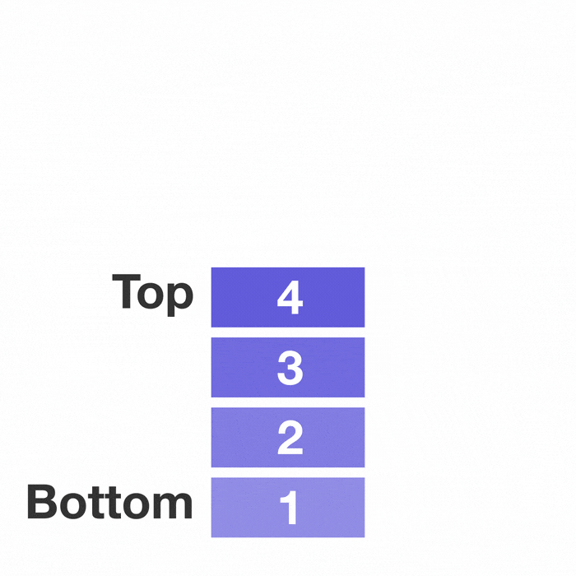
Last In First Out

Slide 37
Array-based Stack Implementation
Allocate an array of some size (pre-defined)
Maximum 𝑁 elements in stack
Associated with each stack is top
Bottom stack element stored at element 0
for an empty stack, set top to -1
last index in the array is the top
Increment top when one element is pushed, decrement it after pop
Push
(1) Increment top by 1
(2) Set Stack[top]=x
Pop
(1) Set return value to Stack[top]
(2) Decrement top by 1.

Slide 38
Stack Class
class Stack {
public:
Stack(int size = 10); // constructor
~Stack() { delete [] values; } // destructor bool IsEmpty() { return top == -1; }
bool IsFull() { return top == maxTop; } double Top();
void Push(const double x);
double Pop();
void DisplayStack();
private:
int maxTop; // max stack size = size - 1 int top; // current top of stack double* values; // element array
};

Slide 39
Create Stack
The constructor of Stack
Allocate a stack array of size. By default, size = 10
When the stack is full, top will have its maximum value, i.e., size – 1
Initially top is set to -1. It means the stack is empty
Stack::Stack(int size /*= 10*/) {
maxTop = size - 1;
values = new double[size];
top = -1;
}
Although the constructor dynamically allocates the stack array, the stack is still static. The size is fixed after the initialization.
Notes:
分配数组
我们分配一个大小为 size 的数组，默认大小是 10。这个数组就是栈的存储空间。
maxTop 的设置
当栈满时，top 的最大值是 size - 1。因为数组下标从 0 开始，所以最大下标是 size - 1。
初始化 top
一开始栈是空的。我们把 top 设置为 -1，表示“没有任何元素”。

Slide 40
Push Stack
void Push(const double x)
Push an element onto the stack
If the stack is full, print the error information
Note top always represents the index of the top element. After pushing an element, top increased by 1
void Stack::Push(const double x) {
if (IsFull())
cout << "Error: the stack is full." << endl;
else
values[++top] = x;
}

Slide 41
Pop Stack
double Pop()
Pop and return the element at the top of the stack
If the stack is empty, print the error information. (In this case, the return value is useless.)
Don’t forgot to decrement top
double Stack::Pop() {
if (IsEmpty()) {
cout << "Error: the stack is empty." << endl; return -1;
} else {
return values[top--];
}
}

Slide 42
Remaining Methods (array based)
double Stack::isEmpty() {
return top == -1;
}
double Stack::isFull() {
return top == maxTop;
}

Slide 43
Algorithm Analysis
Push
Pop
isEmpty
isFull
𝑂(? )
𝑂(? )
𝑂(? )
𝑂(? )

Slide 44
Implementing a Stack: Linked List
Advantages
always constant time to push or pop an element
can grow to an infinite size
Disadvantage
the common case is slower
can grow to an infinite size
Basic implementation
list is initially empty
push() method adds a new item to the head of the list
pop() method removes the head of the list
Notes:
Push / Pop 始终是 O(1)
插入或删除节点只发生在链表的头部，操作时间是常数级别。
没有固定大小限制
链表可以根据需要动态增长。理论上，只要内存足够，栈可以无限扩展。
缺点 (Disadvantages)
性能略慢 因为链表节点不是连续存储，CPU 缓存命中率差。相比数组栈，常见情况下会慢一些。
可能无限增长 如果没有内存限制，链表栈可能无限变大，导致程序占用太多内存。

Slide 45
List-based Stack Implementation: Push
void push(element item)
{
/* add an element to the top of the stack */ pnode temp = (pnode) malloc (sizeof (node)); if (IS_FULL()) {
fprintf(stderr, “ The memory is full\n”);
exit(1);
}
temp->item = item;
temp->next = top;
top = temp;
}

Slide 46
Pop
element pop(pnode top) {
/* delete an element from the stack */
pnode temp = top;
element item;
if (IS_EMPTY(temp)) {
fprintf(stderr, “The stack is empty\n”);
exit(1);
}
item = temp->item;
top = temp->next;
free(temp);
return item;
}

Slide 47
Algorithm Analysis
Push
Pop
isEmpty
𝑂(? )
𝑂(? )
𝑂(? )

Slide 48
Applications
Balancing Symbols
Evaluation of Postfix Expressions
Infix to Postfix conversion

Slide 49
Balancing Symbols
To check that every right brace, bracket, and parentheses must correspond to its left counterpart
e.g., [( )] is legal, but [( ] ) is illegal
A stack is useful for checking symbol balance. When a closing symbol is found it must match the most recent opening symbol of the same type.
Applicable to checking html and xml tags!

Slide 50
Balancing Symbols
Algorithm
Make an empty stack
Read characters until end of file
If the character is an opening symbol, push it onto the stack
If it is a closing symbol, then if the stack is empty, report an error
Otherwise, pop the stack. If the symbol popped is not the corresponding opening symbol, then report an error
At the end of file, if the stack is not empty, report an error

Slide 51
Mathematical Calculations
What does 3 + 2 * 4 equal?
2 * 4 + 3?
(3 + 2) * 4?

Slide 52
Mathematical Calculations
What does 3 + 2 * 4 equal?
2 * 4 + 3?
(3 + 2) * 4?
A mathematical expression cannot simply be evaluated left to right
The precedence of operators affects the order of operations

Slide 53
Infix and Postfix Expressions
The way we use to write expressions is known as infix notation
Postfix notation is a notation that the operands appear before their operators
Postfix expression does not require any precedence rules
3 2 * 1 + is postfix of 3 * 2 + 1

Slide 54
Evaluation of Postfix Expressions
Easy to do with a stack
Given a proper postfix expression:
get the next token
if it is an operand push it onto the stack
else if it is an operator
pop the stack for the right-hand operand
pop the stack for the left-hand operand
apply the operator to the two operands
push the result onto the stack
when the expression has been exhausted, the result is the top (and only element) of the stack

Slide 55
Clicker Question
What does the following postfix expression evaluate to?
6 3 2 + *
A. 18
B. 36
C. 24
D. 11
E. 30

Slide 56
Clicker Question
What does the following postfix expression evaluate to?
6 3 2 + *
A. 18
B. 36
C. 24
D. 11
E. 30

Slide 57
Evaluation of Postfix Expressions
The time to evaluate a postfix expression is 𝑂(𝑛)
processing each element in the input consists of stack operations and thus takes constant time
Evaluate the following postfix expressions and write out a corresponding infix expression:
2 | 5 | ^ | 1 | −
2 | 3 | 2 | 4 | ∗ | + | ∗
1 | 2 | 3 | 4 | ^ | ∗ | +
1 | 2 | − | 3 | 2 | ^ | 3 ∗ 6 / +

Slide 58
Infix to Postfix Conversion
Requires operator precedence parsing algorithm
Parse: To determine the syntactic structure of a sentence or other utterance
Operands: add to the output expression
Open parenthesis: push onto stack
Close parenthesis: pop stack symbols until an open parenthesis appears
Operators:
Compare on stack and off stack precedence, except open parenthesis
Pop all stack symbols until a symbol of lower precedence appears. Then push the operator
End of input: Pop all remaining stack symbols and add to the output expression

Slide 59
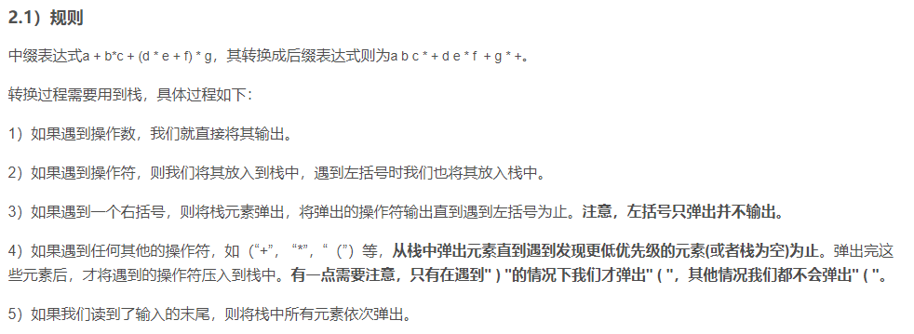
Infix to Postfix Conversion
https://blog.csdn.net/sgbfblog/article/details/8001651

Slide 60
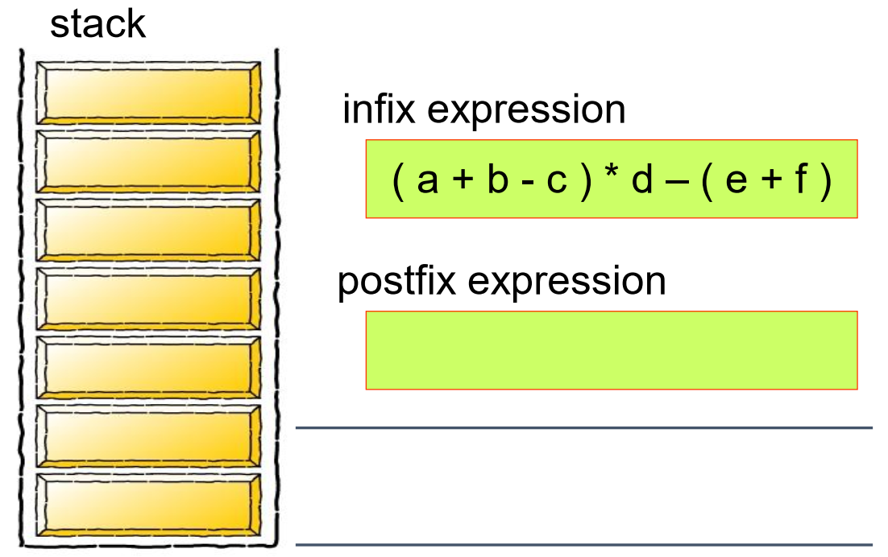
Infix to Postfix Conversion

Slide 61

Infix to Postfix Conversion

Slide 62
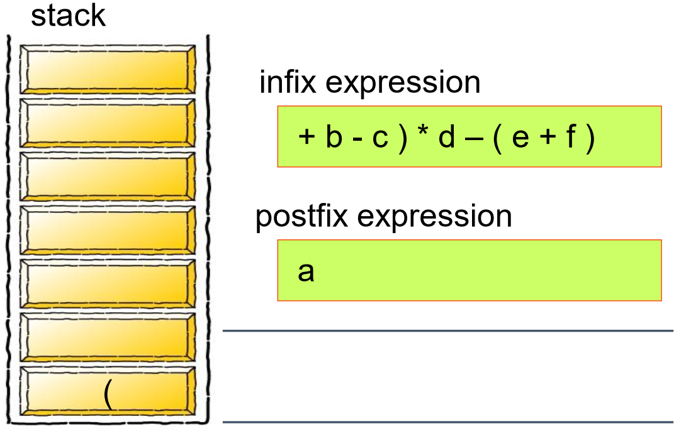
Infix to Postfix Conversion

Slide 63
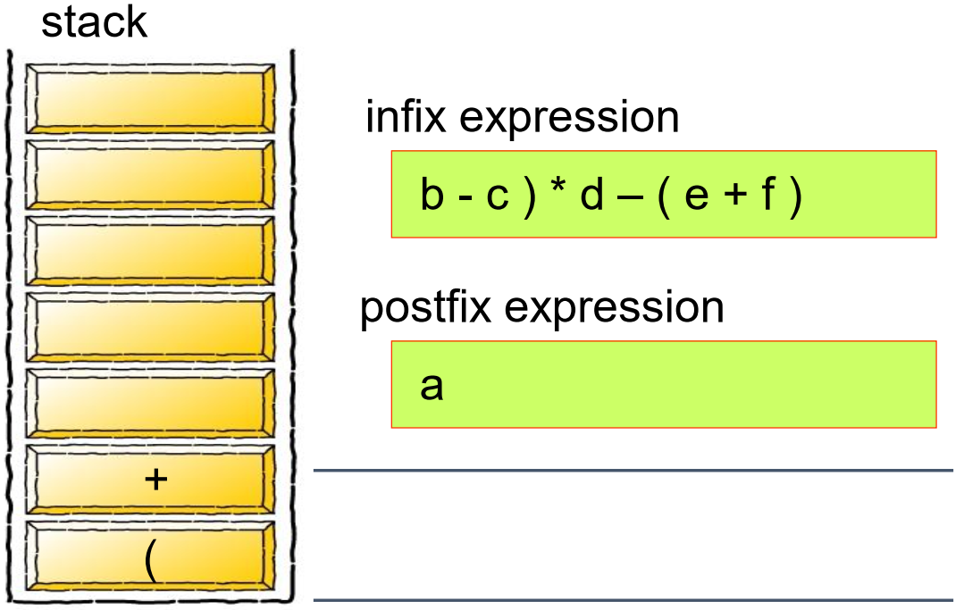
Infix to Postfix Conversion

Slide 64
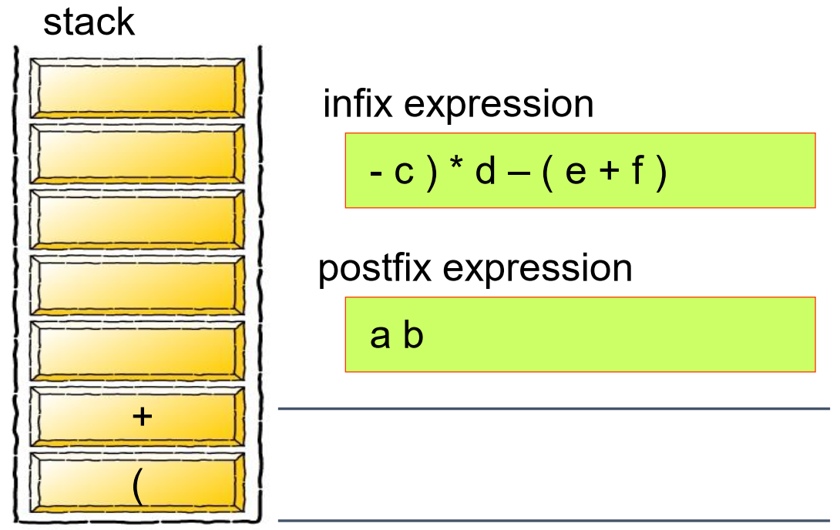
Infix to Postfix Conversion

Slide 65

Infix to Postfix Conversion

Slide 66
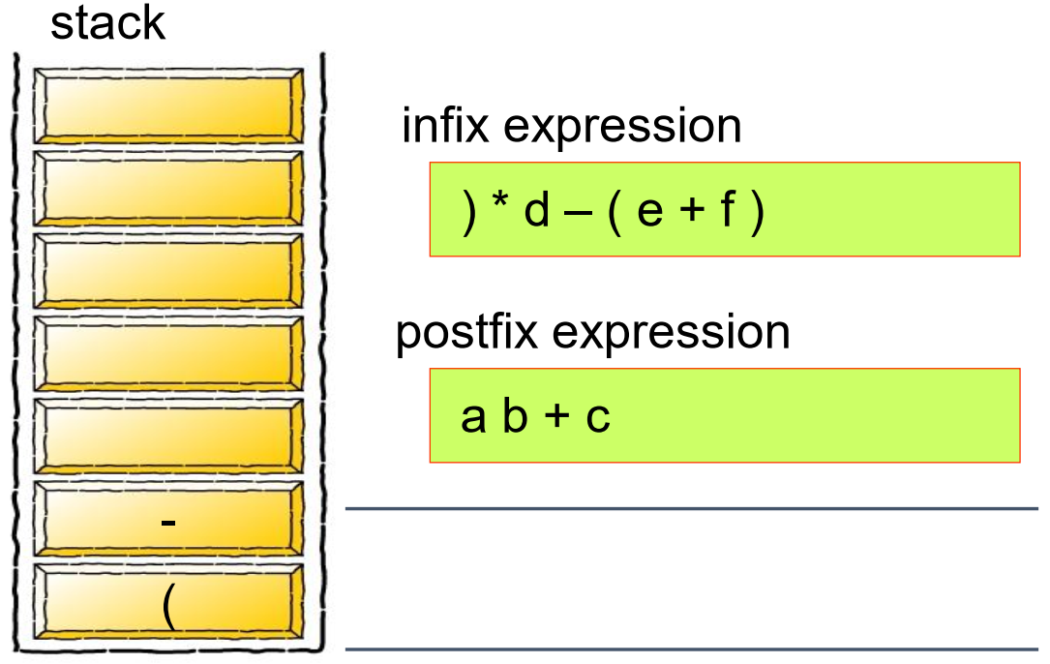
Infix to Postfix Conversion

Slide 67
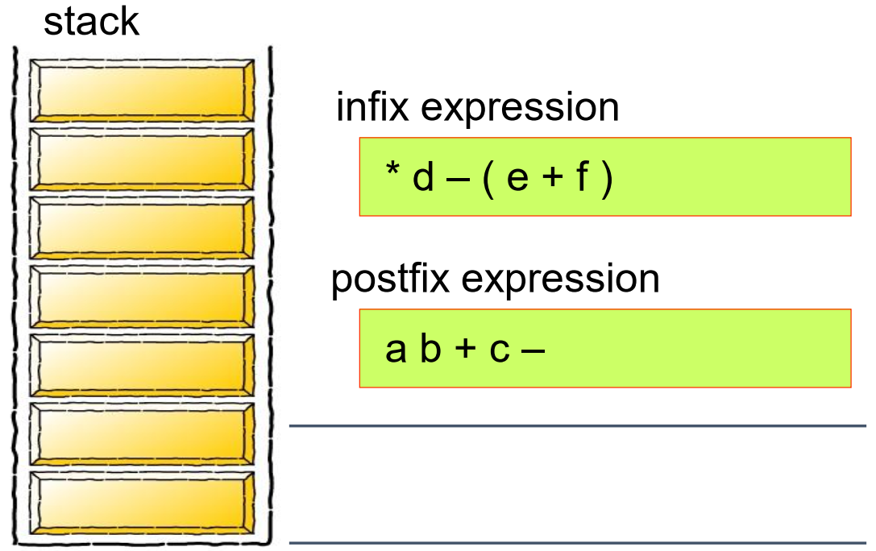
Infix to Postfix Conversion

Slide 68
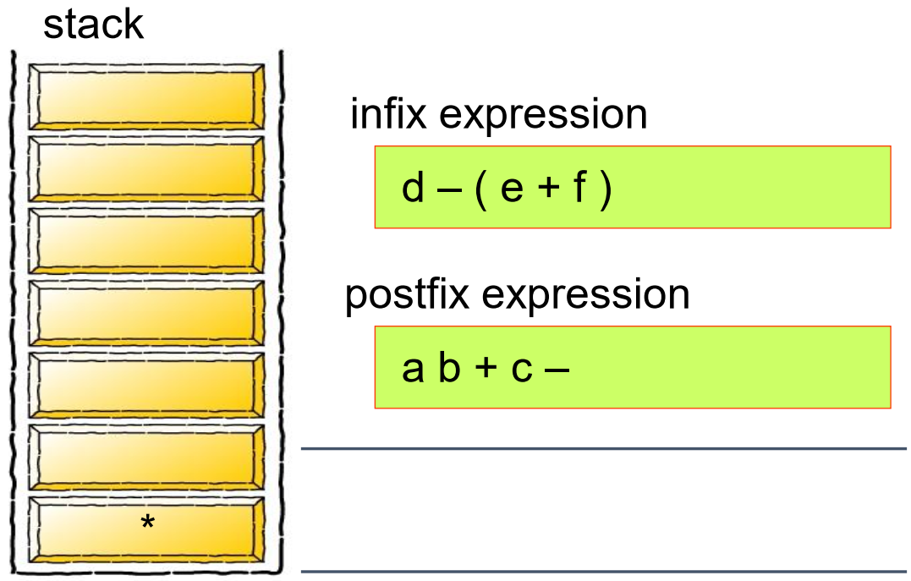
Infix to Postfix Conversion

Slide 69
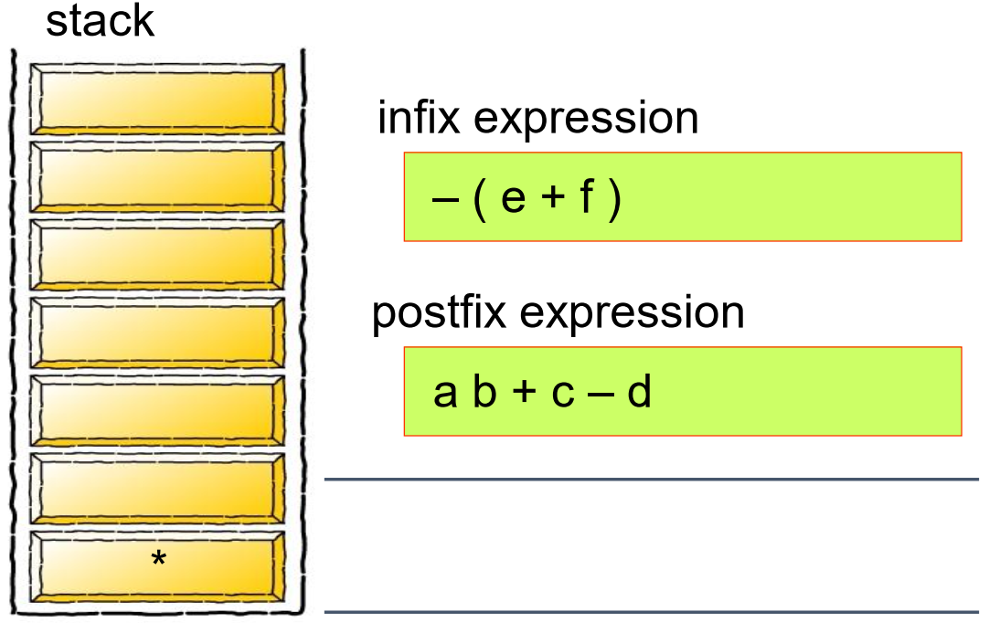
Infix to Postfix Conversion

Slide 70
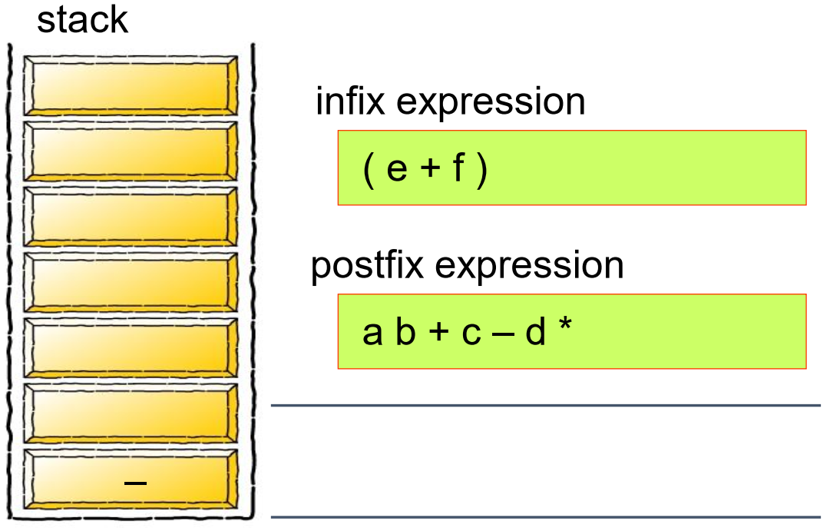
Infix to Postfix Conversion

Slide 71
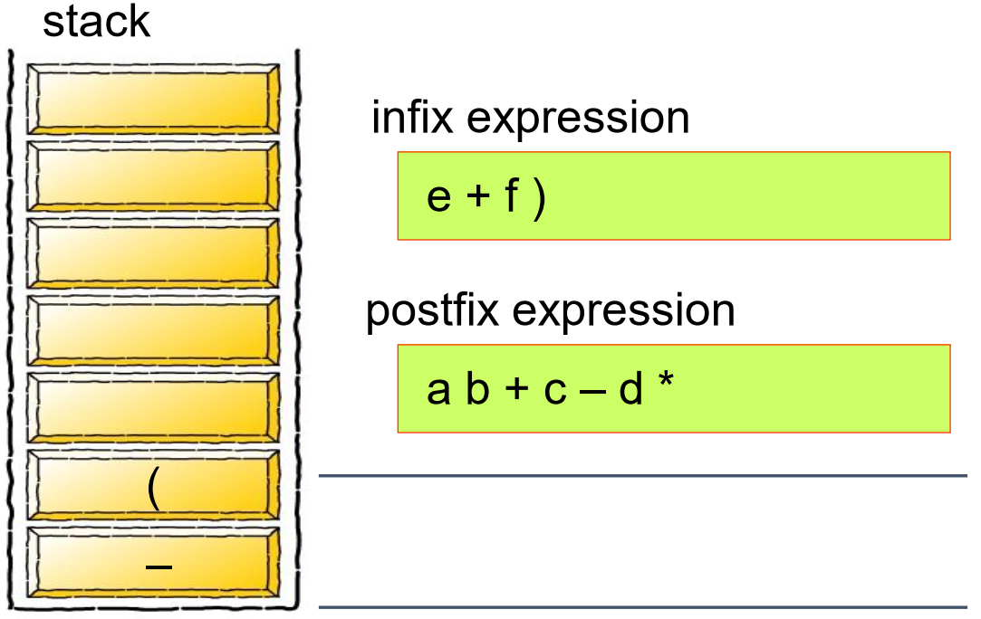
Infix to Postfix Conversion

Slide 72
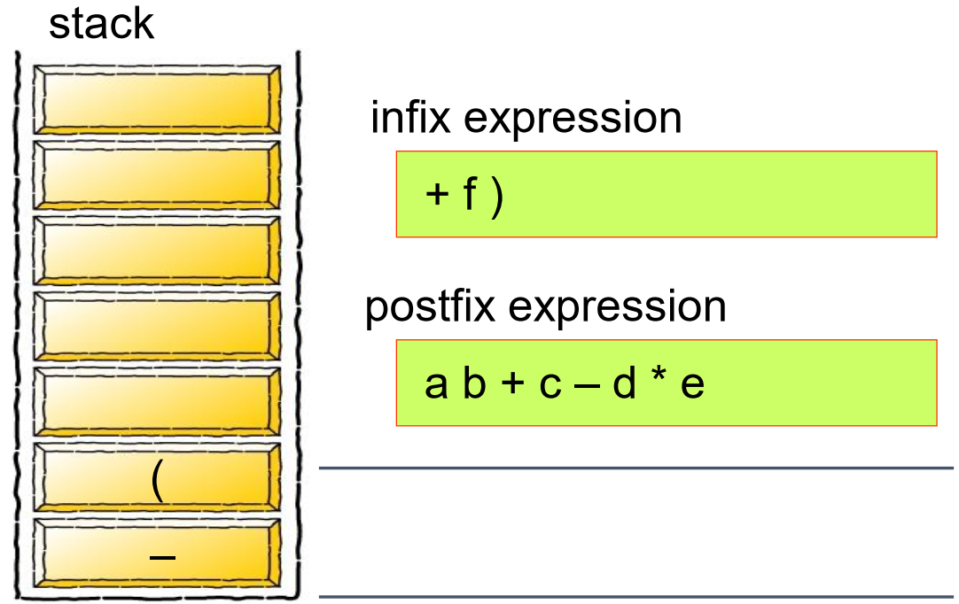
Infix to Postfix Conversion

Slide 73
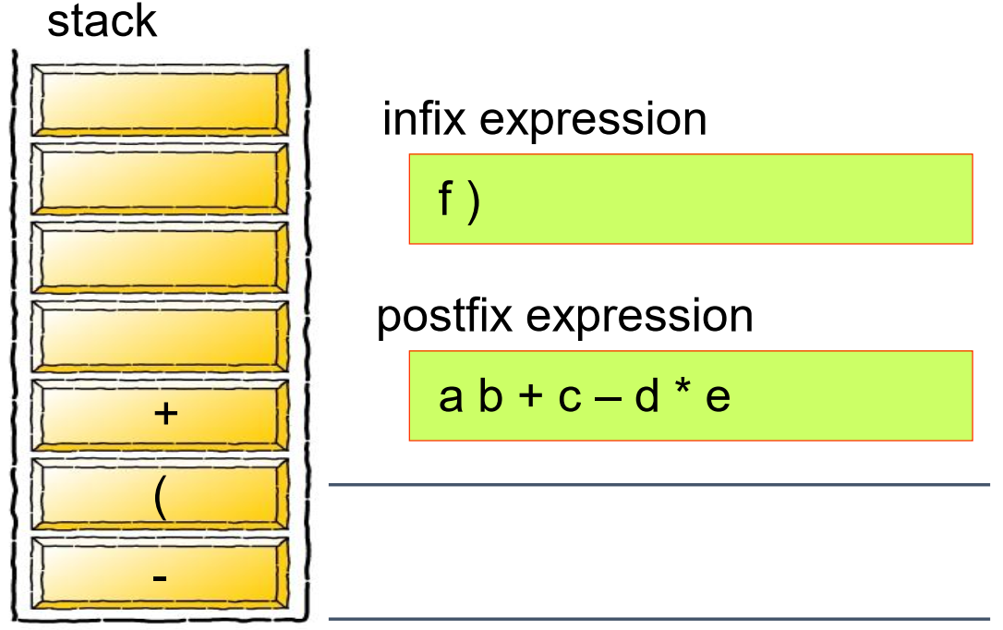
Infix to Postfix Conversion

Slide 74
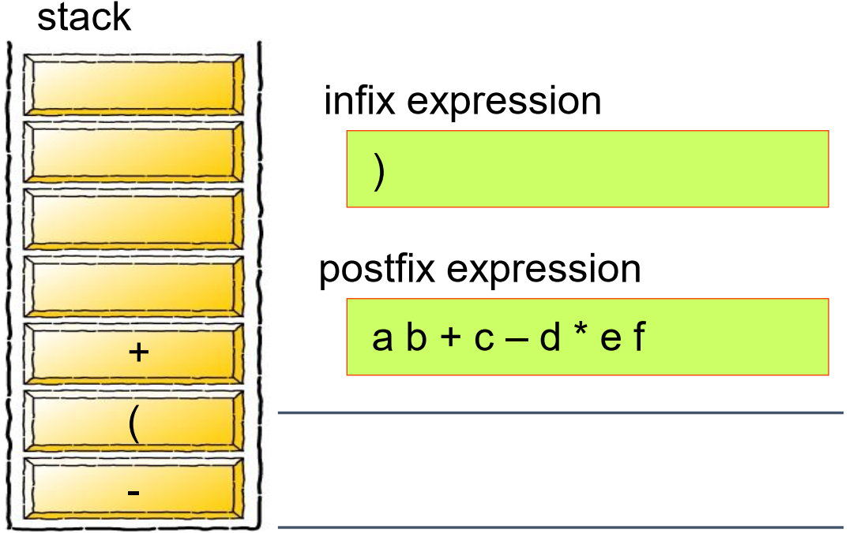
Infix to Postfix Conversion

Slide 75
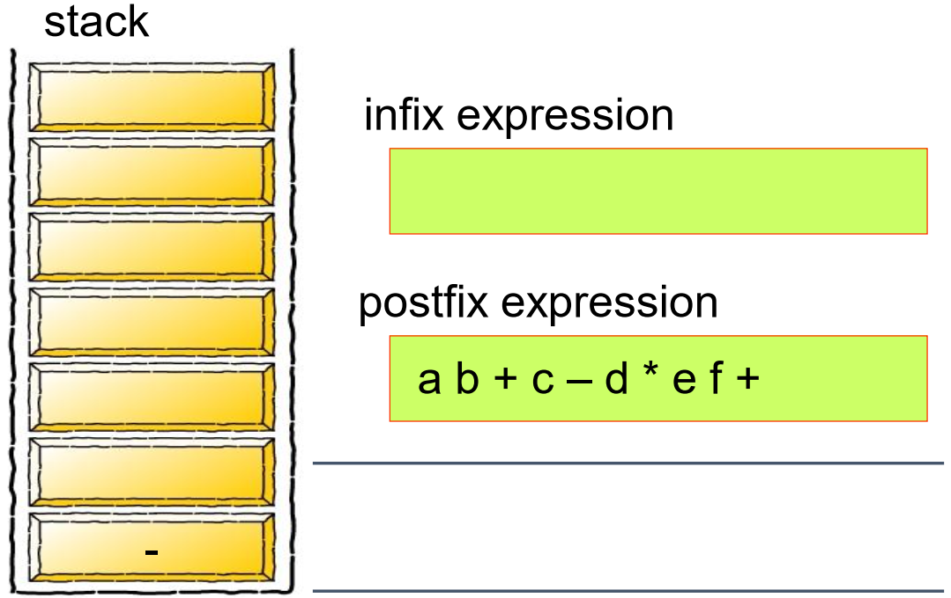
Infix to Postfix Conversion

Slide 76
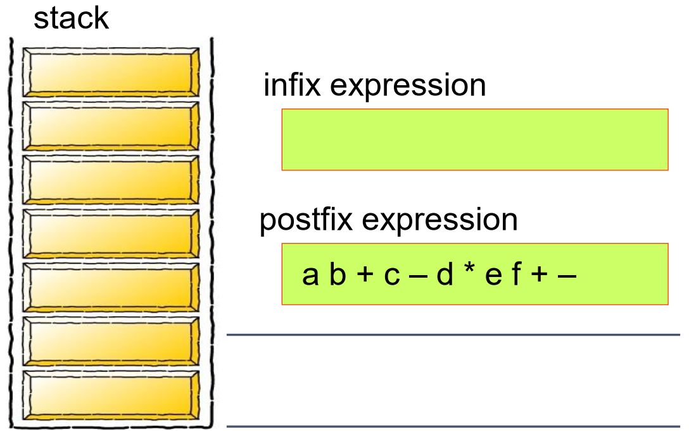
Infix to Postfix Conversion

Slide 77
Infix to Postfix
Convert the following equations from infix to postfix:
(2 ^ 3) ^ 3 + 5 * 1
1 + 2 - 1 * 3 / 3 + 2 ^ 2 / 3

Slide 78
Queue Overview
Queue ADT
Basic operations of queue
Enqueuing, dequeuing, etc
Implementation of queue
Array
Linked list
Notes:
今天我们来学习 Queue（队列） 这一种非常常见的数据结构。我们将会学习一些与queue相关的基本操作，比如enqueue， dequeue。我们将会介绍两种不同的方式去实现queuq，array-based和linked list-based

Slide 79
The Queue ADT
Another form of restricted list
Insertion is done at one end, whereas deletion is performed at the other end
Basic operations of queue
enqueue: insert an element at the rear of the list
dequeue: delete the element at the front of the list
First-in First-out (FIFO) list
dequeue
Queue
enqueue
Notes:
队列其实是一种 受限制的线性表。它的特别之处在于：插入操作只能在一端进行，而删除操作只能在另一端进行。这就和我们日常生活中的排队非常类似
在队列中，主要有两种基本操作：
Enqueue（入队）：把一个新元素插入到队列的 尾部
Dequeue（出队）：从队列的 头部（front） 删除一个元素。
这张图就很直观地展示了操作方向：红色箭头代表 入队，蓝色箭头代表 出队。
队列遵循的原则是 First-In First-Out（FIFO，先进先出）

Slide 80

Queue Applications
Real life examples
Waiting in line
Waiting on hold for tech support
Applications related to Computer Science
Threads
Job scheduling (e.g., Round-Robin algorithm for CPU allocation)
Notes:
队列在我们的日常生活中随处可见. 排队（Waiting in line）：比如超市收银、银行取号排队，都是典型的 FIFO 模式.
等待技术支持电话（Waiting on hold for tech support）：当你打客服电话时，系统会把你放入一个队列，谁先打进来谁先被接听
队列在计算机领域更是核心结构之一. 线程（Threads）：程序中多个线程常常按照队列的方式来调度，确保公平和有序。作业调度（Job Scheduling）：比如操作系统中的 时间片轮转调度算法（Round-Robin for CPU allocation）。进程会被排成一个队列，CPU 依次为每个进程分配时间片，执行完后重新入队，直到所有任务完成。

Slide 81
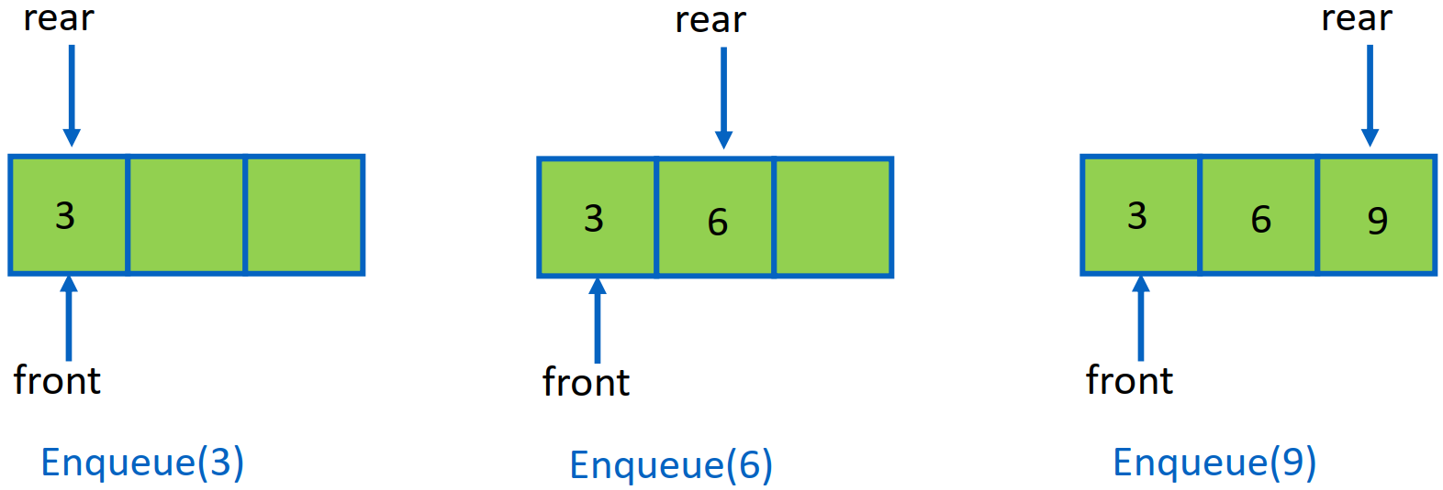
Queue Implementation of Array
There are several different algorithms to implement Enqueue and Dequeue
Naïve way
When enqueuing, the front index is always fixed, and the rear index moves forward in the array
Notes:
数组实现队列有多种算法，今天我们先从最基础的方法开始。
在数组实现中，我们需要两个关键的指针：front（队首）：指向队列中第一个元素的位置；rear（队尾）：指向队列中最后一个元素的位置。
在最简单的方式中：队首指针 front 始终固定，入队时，新的元素总是放在 rear 之后，然后 rear 往后移动。”

Slide 82
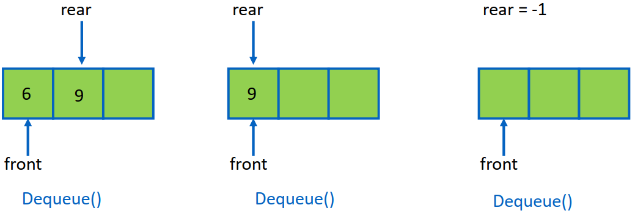
Queue Implementation of Array
Naïve way
When enqueuing, the front index is always fixed, and the rear index moves forward in the array
When dequeuing, the element at the front the queue is removed. Move all the elements after it by one position. (Inefficient!!!)

Slide 83
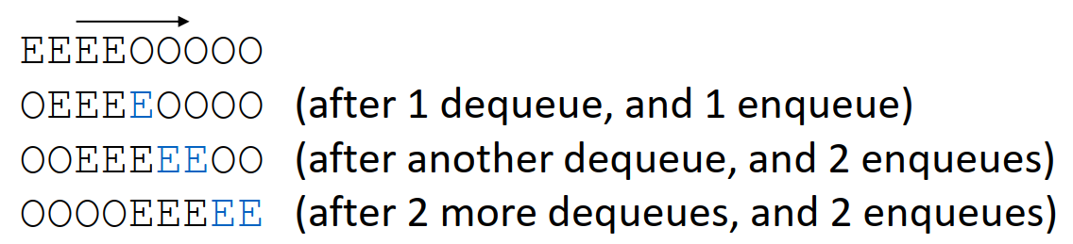
Queue Implementation of Array
Better way
When an item is enqueued, make the rear index move forward
When an item is dequeued, the front index moves by one element towards the back of the queue (thus removing the front item, so no copying to neighboring elements is needed)
The problem here is that the rear index cannot move beyond the last element in the array.

Slide 84
Implementation using Circular Array
Using a circular array
When an element moves past the end of a circular array, it wraps around to the beginning, e.g.,
OOOOO7963 -> 4OOOO7963 (after Enqueue(4))
After Enqueue(4), the rear index moves to 0

Slide 85
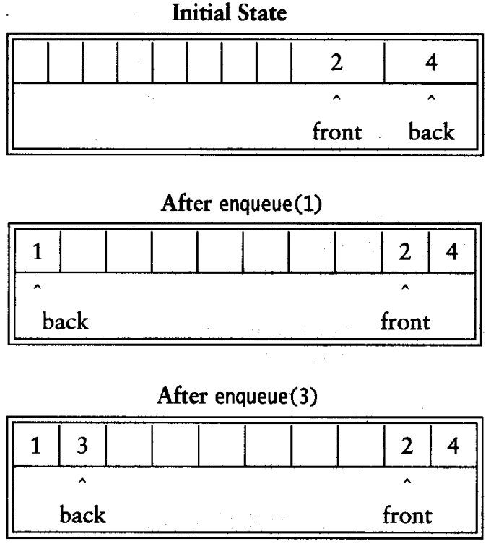
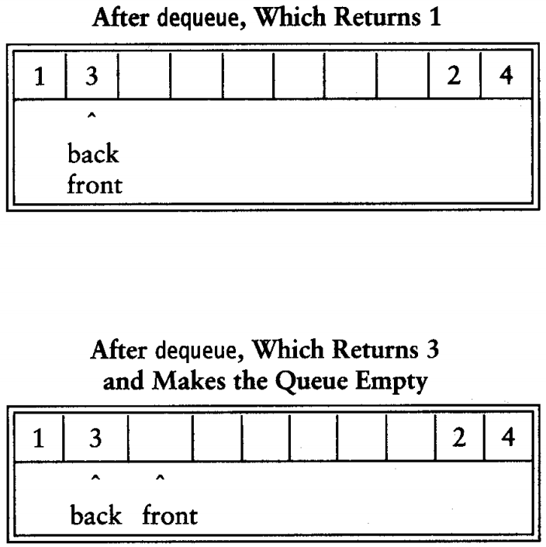
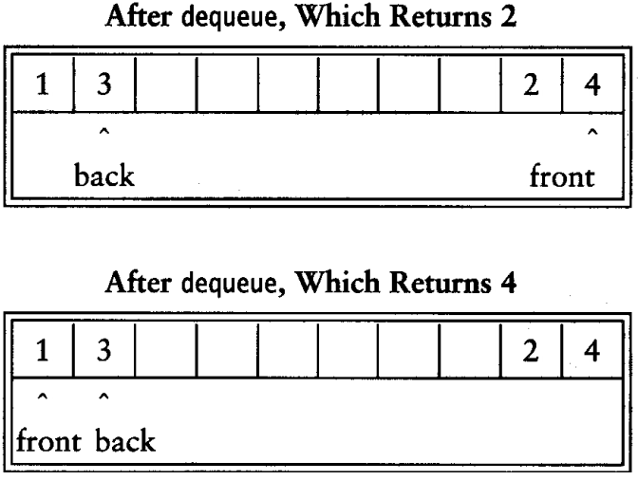
Implementation using Circular Array

Slide 86
Empty or Full?
Empty queue
rear = front - 1
Full queue?
the same!
Reason: 𝑛 values to represent 𝑛 + 1 states
Solutions
Use a boolean variable to say explicitly whether the queue is empty or not
Make the array of size 𝑛 + 1 and only allow 𝑛 elements to be stored
Use a counter of the number of elements in the queue

Slide 87
Queue Implementation of Circular Array
class Queue {
public:
Queue(int size = 10); // constructor
~Queue() { delete [] values; } // destructor
bool IsEmpty(void);
bool IsFull(void);
bool Enqueue(double x);
bool Dequeue(double & x);
void DisplayQueue(void);
private:
int front; // front index
int rear; // rear index
int counter; // number of elements
int maxSize; // size of array queue
double* values; // element array
};

Slide 88
Create Queue
Allocate a queue array of size. By default, size = 10
front is set to 0, pointing to the first element of the array
rear is set to -1. The queue is empty initially
Queue::Queue(int size /* = 10 */) {
values = new double[size];
maxSize = size;
front = 0;
rear = -1;
counter = 0;
}

Slide 89
IsEmpty & IsFull
Since we keep track of the number of elements that are actually in the queue: counter, it is easy to check if the queue is empty or full
bool Queue::IsEmpty() {
if (counter) return false;
else return true;
}
bool Queue::IsFull() {
if (counter < maxSize)
return false;
else
return true;
}

Slide 90
Enqueue
bool Queue::Enqueue(double x) {
if (IsFull()) {
cout << "Error: the queue is full." << endl; return false;
}
else {
// calculate the new rear position (circular) rear = (rear + 1) % maxSize;
// insert new item
values[rear] = x;
// update counter
counter++; return true;
}
}

Slide 91
Dequeue
bool Queue::Dequeue(double & x) {
if (IsEmpty()) {
cout << "Error: the queue is empty." << endl;
return false;
}
else {
// retrieve the front item
x = values[front];
// move front
front = (front + 1) % maxSize;
// update counter
counter--;
return true;
}
}

Slide 92
Algorithm Analysis
Enqueue
Dequeue
size
isFull
isEmpty
𝑂(? )
𝑂(? )
𝑂(? )
𝑂(? )
𝑂(? )

Slide 93
List-based Queue Implementation: Enqueue
void enqueue(element item)
{
/* add an element to the rear of the queue */
pnode temp = (pnode) malloc(sizeof (queue));
if (IS_FULL(temp)) {
fprintf(stderr, “ The memory is full\n”);
exit(1);
}
temp->item = item;
temp->next = NULL;
if (front) { (rear) -> next= temp;}
else front = temp;
rear = temp;
}

Slide 94
List-based Queue Implementation: Dequeue
element dequeue(pnode &front)
{
/* delete an element from the queue */
pnode temp = front; element item;
if (IS_EMPTY(front)) {
fprintf(stderr, “The queue is empty\n”);
exit(1);
}
item = temp->item;
front = temp->next;
free(temp);
return item;
}

Slide 95
Algorithm Analysis
Enqueue
Dequeue
size
isFull
isEmpty
𝑂(? )
𝑂(? )
𝑂(? )
𝑂(? )
𝑂(? )

